Slide 1
Welcome to My Presentation

Slide 2
Presented To:
Sadia Islam
Lecturer
Dept. of CSE
City University
Presented By:
Md Pias Hossain
Id:163432563
43 batch

Slide 3
Intermediate Code Generator

Slide 4
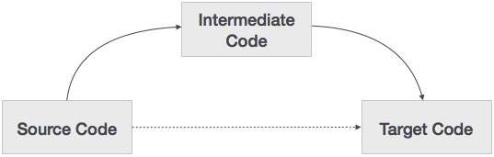
What is intermediate Code Generator?
Its translating source program into an intermediate language to targeted machine language.

Slide 5
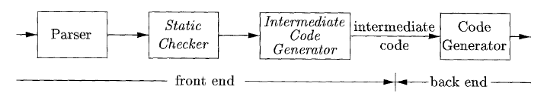
How it’s works?

Slide 6
Benefits of Intermediate code generator
Retargeting is facilitated
Machine independent code optimization can be applied
Many source code convert into three code

Slide 7
Most used Intermediate code representation
Three Address code
Syntax Tree

Slide 8
Three Address Code
A statement involving no more than three references(two for operands and one for result) is known as three address statement.
Example – The three address code for the expression a + b * c + d :
T 1 = b * c T 2 = a + T 1 T 3 = T 2 + d
T 1 , T 2 , T 3 are temporary variables.

Slide 9
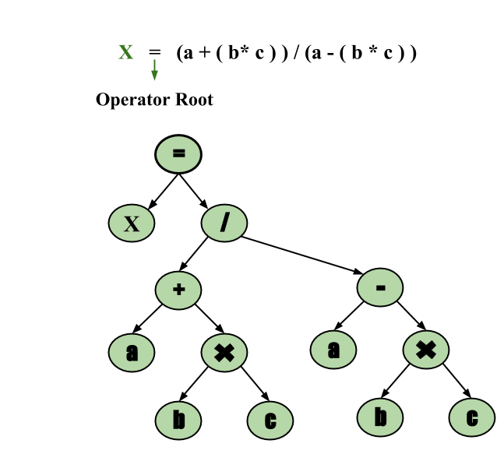
Syntax Tree
Syntax tree is nothing more than condensed form of a parse tree.
Example – x = (a + b * c) / (a – b * c)

Slide 10
Thank You

